Slide 1

Trans-optima Glasses
Max Roslin, Jack Majewski, Dan Mukuna, AidAn Tucker

Slide 2
Digital presentation
Link to Trans-optima Glasses informational video below
Powtoon - Trans-Optima Glasses

Slide 3
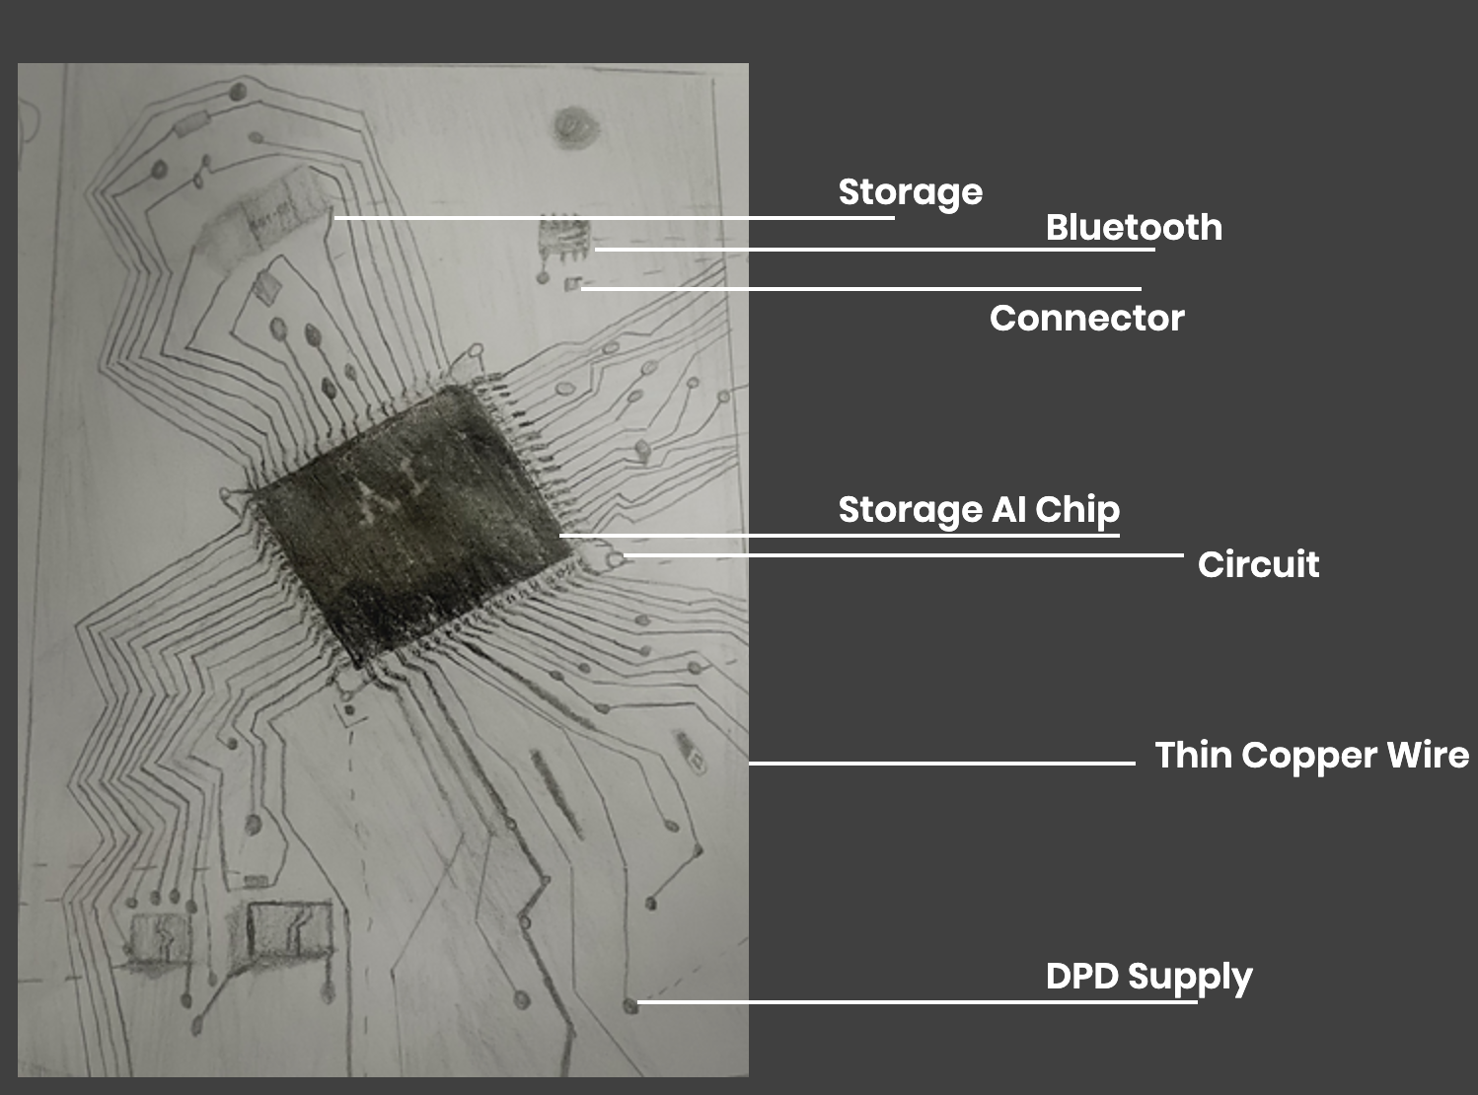
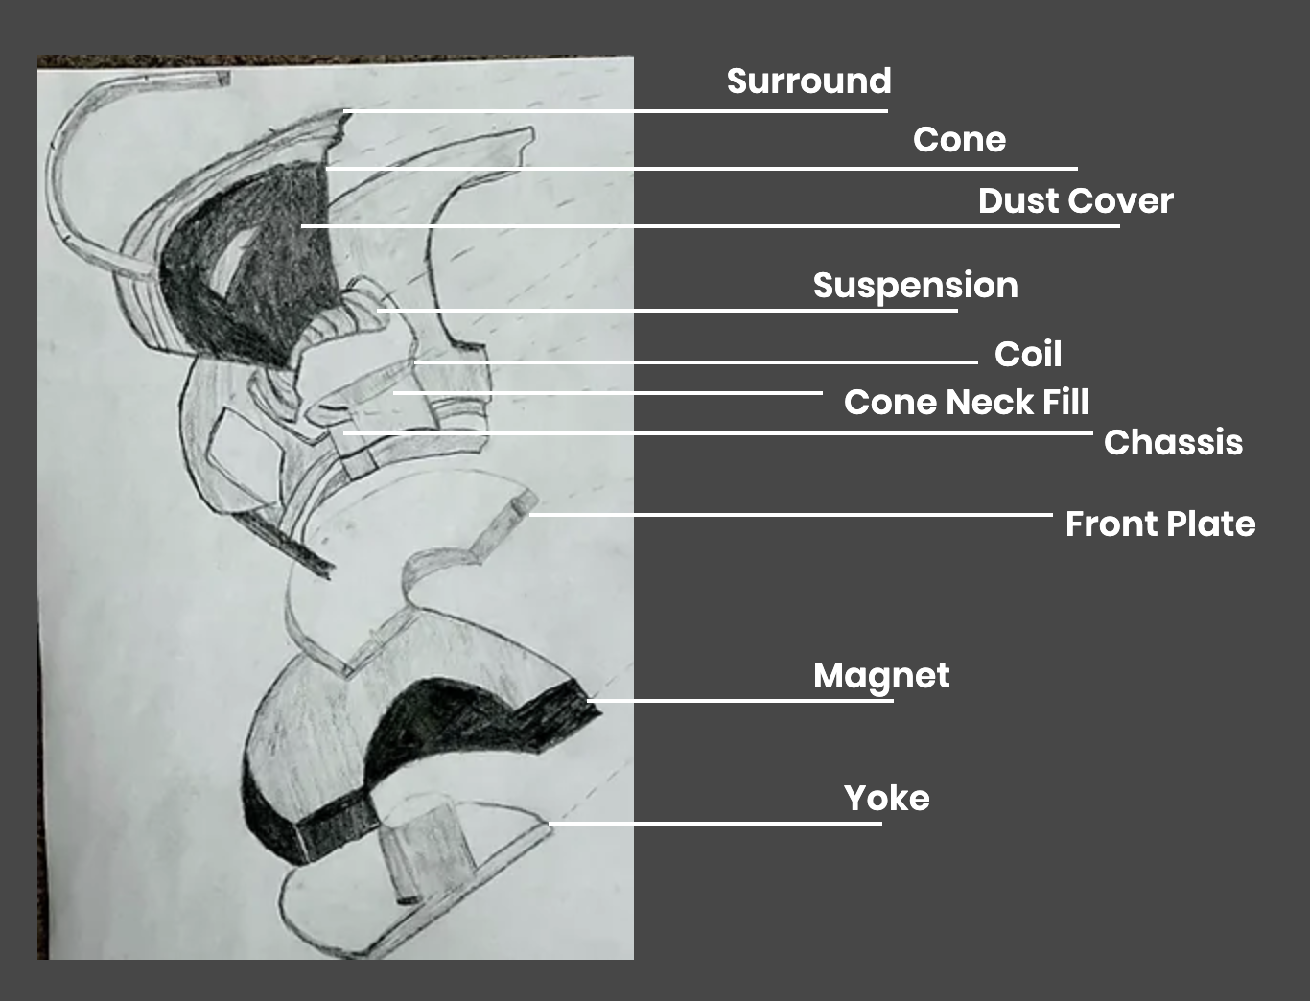
Trans-optima Software
Trans-optima software
Cross reference of lip reading visual cues, and audio and tone detection (goal of near 100% accuracy)
Visually displayed text as preset responses, utilizes eye-tracking technology
The software is what we have created that is so revolutionary
Key Details
Bluetooth incorporated AI translator for English
Everything is integrated in the AI Chip
Interior fitted projector
Microphone/receiver and camera interlinked with our software
Speaker design fig. 2
AI Chip design fig.1

Slide 4
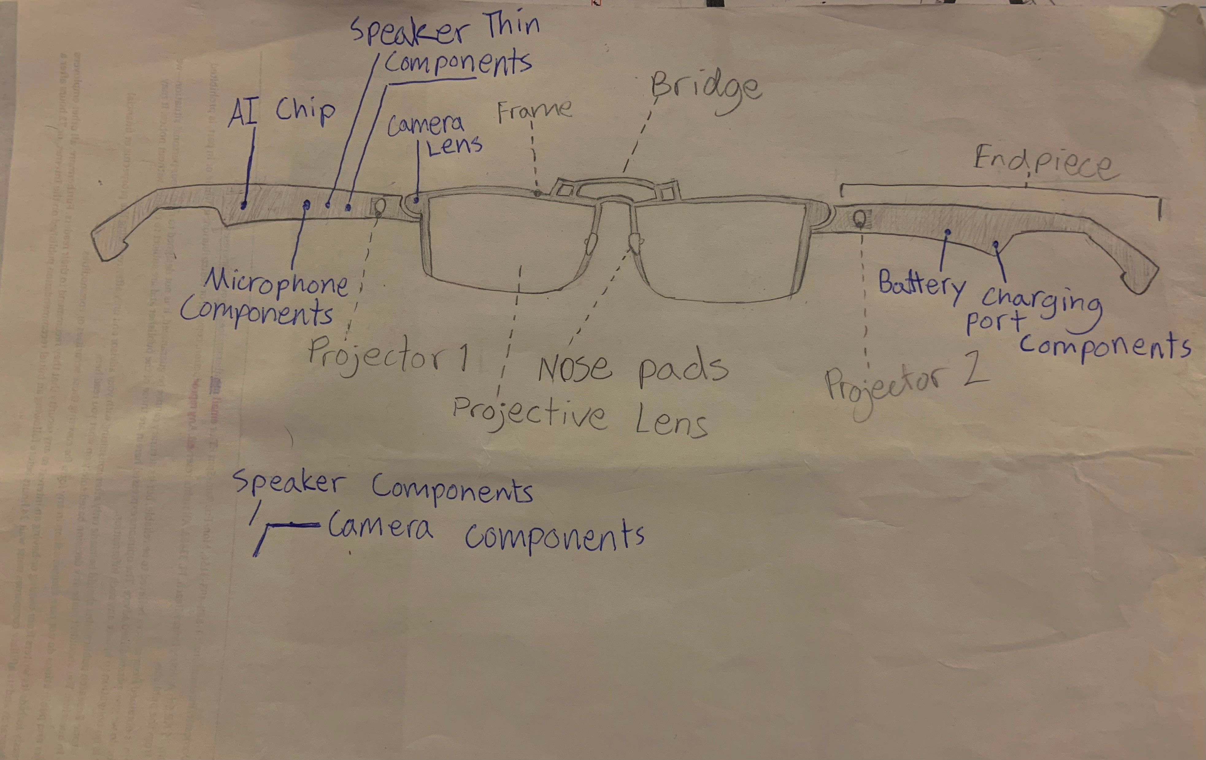
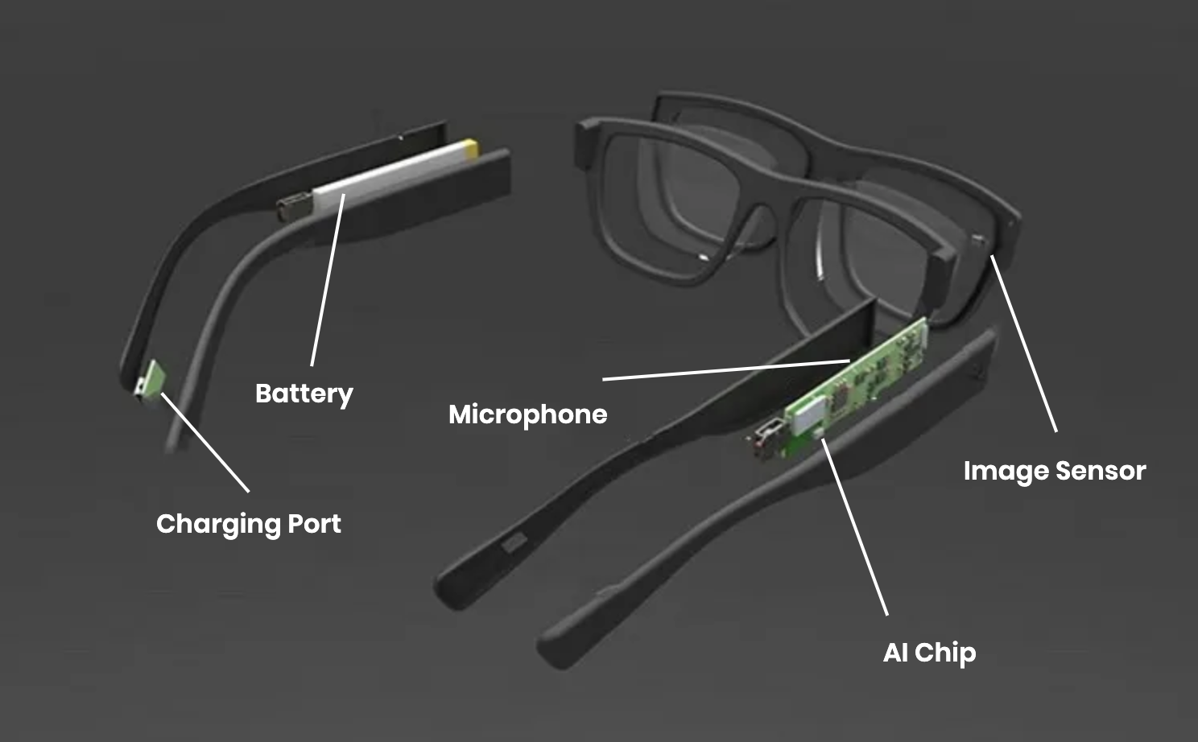
Trans-Optima Hardware
Product Specifications
Titanium Frames (strong as steal but 45 % lighter)
Temple and temple tips constructed of memory metal
Projective film layered over the lens
USB-C charger
Raw Glasses Specifications fig.4
Digitized Glasses specifications fig.4

Slide 5
NECESSITY
BUSINESS
INTERPERSONAL COMMUNICATION
MENTAL HEALTH
The majority (56%) of deaf or hard of hearing employees have experienced discrimination during their career.
Leading to one in four (25%) deaf people leave a job because of a difficult environment
Few non-native sign language speakers
About 90 percent of deaf people are born with hearing able parents
“Deaf children are 5x as likely to be abused as [able] Hearing children. [UK Study]”
“Deaf adults are more likely than the general population to be diagnosed with depression or anxiety disorder at a younger age” (ICPhS2019).

Slide 6
MARKET
- MARKET SPECIFICATIONS
- GLOBAL HARING IMPAIRMENTS
Approximately 37.5 million people age 18 or above have hearing loss
360 million people in the world are deaf or having extreme hearing impairments
There are between 300k and 3M US people with legal deafness
(Includes both fully deaf people and people with severe hearing impairments)
- Approximately 37.5 million people age 18 or above have hearing loss
- 500,000 ASL natural speakers in the US and Canada
- Our goal is to move into the space of marketing to BSL (151k), FSL(80-300k), CSL (up to 20M) speakers

Slide 7
Market Research

Slide 8
COMPETITION
HEARING AIDS
PUBLIC TRANSLATORS
ROBOTIC TRANSLATORS
Is a device that collects sound from small microphones and amplifies the sound based on auditory needs
About 28.8 M US Americans could benefit from hearing Aids
Airports
Train stations
General Public Places
Few applicable translators for the deaf
Only Project Aslan exists (has drawbacks)

Slide 9
Revenue Model
Product Cost
Designed initially to be extremely high quality product
More expensive to produce in comparison to other luxury glasses brand
Software Separation
Our software is one of a kind
Explains the increase in product price
B/C Model
- Trans-optima Glasses are designed as a Business to Consumer product

Slide 10
Citations:
“ICPHS – Phonetic Experts.” How Do Deaf People Feel about Their Place in the World?, https://www.icphs2019.org/.
1 in 4 deaf people have quit their job due to discrimination – Northern Virginia Resource Center for Deaf & Hard of Hearing Persons (nvrc.org)
Statistics on Deafness (gatecommunications.org)
Quick Statistics About Hearing | NIDCD (nih.gov)
Deaf adults are more likely than the general population to be diagnosed with depression or anxiety disorder at a younger age.
-“American Sign Language.” National Institute of Deafness and Other Communication Disorders, U.S. Department of Health and Human Services, https://www.nidcd.nih.gov/health/american-sign-language.
Aslan is the New Robotic Translator for Deaf People - Open Electronics - Open Electronics (open-electronics.org)

